Slide 1
#
C
o
p
y
r
i
g
h
t
©
2
0
1
4
~
2
0
9
9
§9.2 Laplace 㑍㚟㔻㫝㰻
.
㭎㐃㫫㫝㫝㰻㭐㫩㦠㫝㰻
㖎㐃㭹㶟㫝㰻㭐㪌㮊㫝㰻
®
X
i
e
s
o
n
g
f
a
@
H
U
S
T
.
$
9
8
!
㦘㐃㪹㖻㫝㰻
䍤
䈻
㺖
㦰㐃㛺㖻㫝㰻
#
C
o
p
y
r
i
g
h
t
©
2
0
1
4
~
2
0
9
9
.
㪊㐃㯷㤤㙽㨞㔻㫑㙽㨞
㟰㐃㝎㛺㭐㝎㛺㔩㟂
®
X
i
e
s
o
n
g
f
a
@
H
U
S
T
.
$
9
8
䍤
䈻
㺖
!

Slide 2






#
C
o
p
y
r
i
g
h
t
©
2
0
1
4
~
2
0
9
9
§9.2 Laplace 㑍㚟㔻㫝㰻
.
㛔㔷㧤㠗
(1) 㯹㫉㠩㘪㒬㔻㜴㑗㫝㰻㯣㐂
㦼㧺㛘㔟㔻㙽㨞㔻 Laplace
®
X
i
e
s
o
n
g
f
a
@
H
U
S
T
.
$
9
8
!
㑍㚟㛚㛐㔩㒶㯹㐂㤂㩇㠓㔻㯻㱋㰇㨞㛚㛐㔩㪈 c 㐆
(2) 㥟㪒㩛㒁㧤㠗㐂㙽㨞㭐㫑㙽㨞䃙㥩㐖㔧㫛㫕㰱㥣㔫㭮㐂
䍤
䈻
㺖
#
C
o
p
y
r
i
g
h
t
©
2
0
1
4
~
2
0
9
9
.
㑝㥟㐅
(3) 㔫㮺㧺㛘㔟㔻㭎㬙㮘㧒㐁㥟㤴㔭 㛺㖻 㛬㫽㛘㤴㚋㕃㐇
㐃
㐃
®
㔻㓄䌶㛆㚟㪜㩗㐂㛚㐿㞺㯩㧤㠗㐆
X
i
e
s
o
n
g
f
a
@
H
U
S
T
.
$
9
8
䍤
䈻
㺖
!

Slide 3




㭎㐃㫫㫝㫝㰻㭐㫩㦠㫝㰻
#
C
o
p
y
r
i
g
h
t
©
2
0
1
4
~
2
0
9
9
P 217
.
1. 㫫㫝㫝㰻
P 217
㫝㰻䶨䶩
㧞 a , b 㪈㒺㨞㐂
㯱㭼
®
X
i
e
s
o
n
g
f
a
@
H
U
S
T
.
$
9
8
!
䍤
䈻
㺖
㰷㠗䶢䶣
#
㐁㟄㐇
C
o
p
y
r
i
g
h
t
©
2
0
1
4
~
2
0
9
9
.
®
X
i
e
s
o
n
g
f
a
@
H
U
S
T
.
$
9
8
䍤
䈻
㺖
!

Slide 4

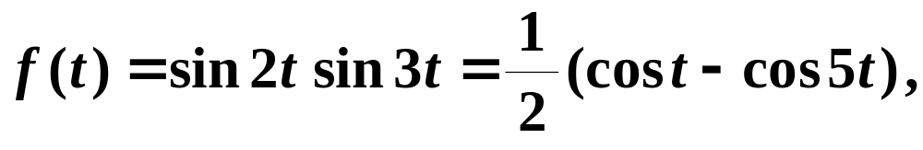
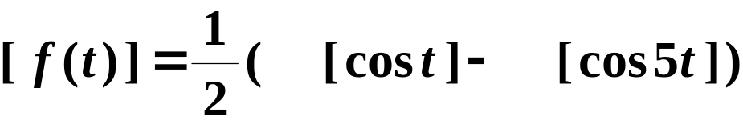
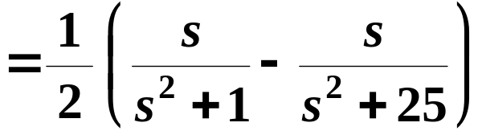
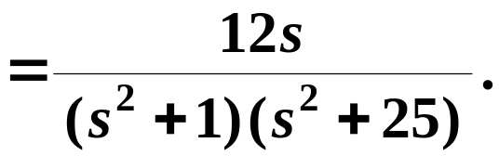
㞶䶅䶆䶇
㤴㙽㨞 㔻 Laplace 㑍㚟㐆
#
C
o
p
y
r
i
g
h
t
©
2
0
1
4
~
2
0
9
9
.
㝀䶩䶪䶫
®
X
i
e
s
o
n
g
f
a
@
H
U
S
T
.
$
9
8
!
䍤
䈻
㺖
#
C
o
p
y
r
i
g
h
t
©
2
0
1
4
~
2
0
9
9
.
®
X
i
e
s
o
n
g
f
a
@
H
U
S
T
.
$
9
8
䍤
䈻
㺖
!

Slide 5
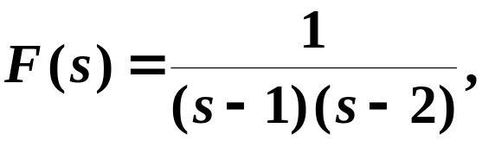

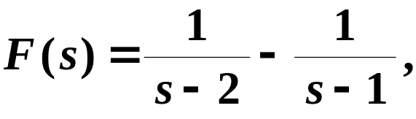

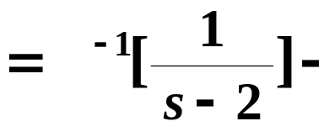
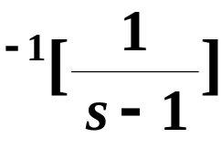

#
C
o
p
y
r
i
g
h
t
©
2
0
1
4
~
2
0
9
9
㞶䶅䶆䶇
.
㭬㰝
㤴
㝀䶩䶪䶫
®
X
i
e
s
o
n
g
f
a
@
H
U
S
T
.
$
9
8
!
䍤
䈻
㺖
#
C
o
p
y
r
i
g
h
t
©
2
0
1
4
~
2
0
9
9
.
®
X
i
e
s
o
n
g
f
a
@
H
U
S
T
.
$
9
8
䍤
䈻
㺖
!

Slide 6
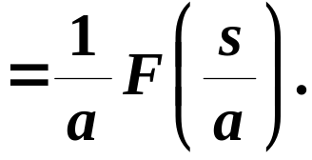

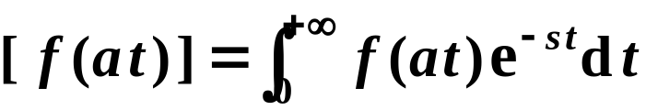
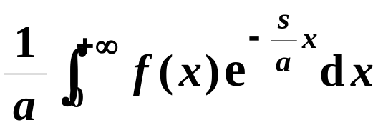


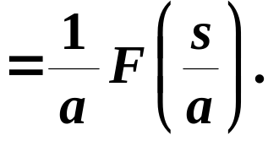
㭎㐃㫫㫝㫝㰻㭐㫩㦠㫝㰻
#
C
o
p
y
r
i
g
h
t
©
2
0
1
4
~
2
0
9
9
.
2. 㫩㦠㫝㰻㐁㚑㓰㔱㫝㰻㐇
P 218
㫝㰻䶨䶩
㧞 a 㪈㥷㭎㰓㦴㨞㐂
㯱㭼
®
X
i
e
s
o
n
g
f
a
@
H
U
S
T
.
$
9
8
!
㰷㠗䶢䶣
䍤
䈻
㺖
㞴
#
C
o
p
y
r
i
g
h
t
©
2
0
1
4
~
2
0
9
9
.
®
X
i
e
s
o
n
g
f
a
@
H
U
S
T
.
$
9
8
䍤
䈻
㺖
!

Slide 7




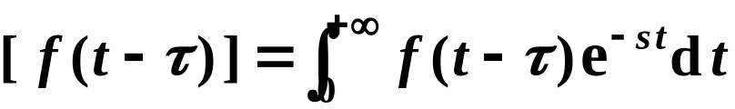
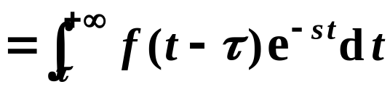

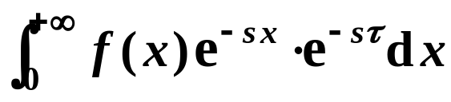


㖎㐃㭹㶟㫝㰻㭐㪌㮊㫝㰻
#
C
o
p
y
r
i
g
h
t
©
2
0
1
4
~
2
0
9
9
P 223
.
1. 㭹㶟㫝㰻
P 223
㫝㰻䶨䶩
㧞㔳 t < 0 㧀
㯱㔫㥷㭎㗛㗓㦴㨞 㐂
㭼
®
X
i
e
s
o
n
g
f
a
@
H
U
S
T
.
$
9
8
!
㰷㠗䶢䶣
䍤
䈻
㺖
#
C
o
p
y
r
i
g
h
t
©
2
0
1
4
~
2
0
9
9
.
㞴
®
X
i
e
s
o
n
g
f
a
@
H
U
S
T
.
$
9
8
䍤
䈻
㺖
!

Slide 8




㖎㐃㭹㶟㫝㰻㭐㪌㮊㫝㰻
#
C
o
p
y
r
i
g
h
t
©
2
0
1
4
~
2
0
9
9
P 223
.
1. 㭹㶟㫝㰻
P 223
㫝㰻䶨䶩
㧞㔳 t < 0 㧀
㯱㔫㥷㭎㗛㗓㦴㨞 㐂
㭼
®
X
i
e
s
o
n
g
f
a
@
H
U
S
T
.
$
9
8
!
㰕㭶䶣䶤
㯹㭹㶟㫝㰻㯣㯡㠧㤢㹙㞲㔳 t < 0 㧀 㱁㭎㮌㔩㐆
䍤
䈻
㺖
#
C
o
p
y
r
i
g
h
t
©
2
0
1
4
~
2
0
9
9
㦞㦴㦚㐂㘰㫝㰻㝳㭖㰙㛦㑣㧨㪈㐅
.
㭨㓆㐂㯹㟠㮀㘰㫝㰻㤴㡨㑍㚟㧀㐂
㭮㪈㐅
®
X
i
e
s
o
n
g
f
a
@
H
U
S
T
.
$
9
8
䍤
䈻
㺖
!

Slide 9
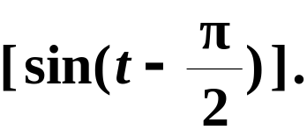
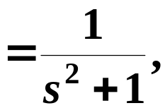

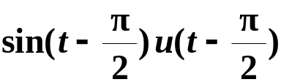
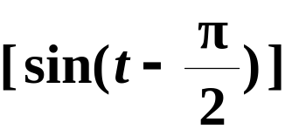
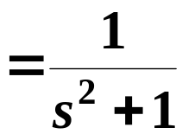
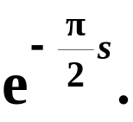



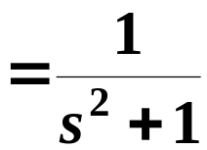

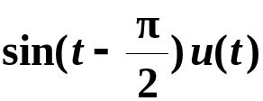
#
C
o
p
y
r
i
g
h
t
©
2
0
1
4
~
2
0
9
9
㞶䶅䶆䶇
.
㤴
P 223 例 9.12
㗉㗡㭎 㫓㒪㟬㯯㣛㮊
㝀䶩䶪䶫
㗉㗡㭎
㭬㰝
®
X
i
e
s
o
n
g
f
a
@
H
U
S
T
.
$
9
8
㘤㾦㭹㶟㫝㰻㐂
!
㭼
䍤
䈻
㺖
㗉㗡㖎 㫓㣛㮊㯯㒪㟬
#
C
o
p
y
r
i
g
h
t
©
2
0
1
4
~
2
0
9
9
.
㗉㗡㖎
®
X
i
e
s
o
n
g
f
a
@
H
U
S
T
.
$
9
8
䍤
䈻
㺖
!
㟦㱧㗉㗡㪈㨀㡑㙷㕛㔟㐿㩃㔻㜊㘢 ?

Slide 10
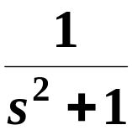
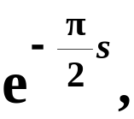


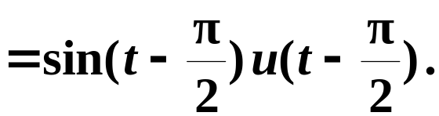



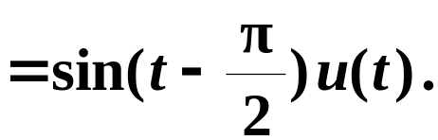



#
C
o
p
y
r
i
g
h
t
©
2
0
1
4
~
2
0
9
9
㞶䶅䶆䶇
.
㤴
P 223 例 9.12
㗉㗡㭎 㫓㒪㟬㯯㣛㮊
㗙 䶂䶃䶄
㟦㱧㜊㘢㔻㡨㑍㚟㔫㑝㐆
(1) 㔫㮺
®
X
i
e
s
o
n
g
f
a
@
H
U
S
T
.
$
9
8
!
䍤
䈻
㺖
㗉㗡㖎 㫓㣛㮊㯯㒪㟬
#
C
o
p
y
r
i
g
h
t
©
2
0
1
4
~
2
0
9
9
.
(2) 㔫㮺
方法一
®
X
i
e
s
o
n
g
f
a
@
H
U
S
T
.
$
9
8
䍤
䈻
㺖
!
方法二

Slide 11
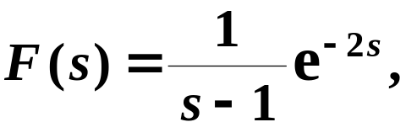

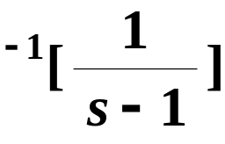



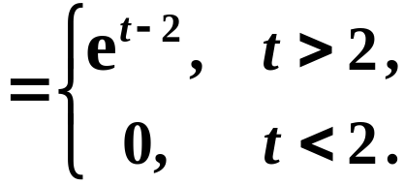
#
C
o
p
y
r
i
g
h
t
©
2
0
1
4
~
2
0
9
9
㞶䶅䶆䶇
㧞 㤴
.
P 224 例 9.13
修改
㭬㰝
㝀䶩䶪䶫
®
X
i
e
s
o
n
g
f
a
@
H
U
S
T
.
$
9
8
!
㘤㾦㭹㶟㫝㰻㐂
㭼
䍤
䈻
㺖
#
C
o
p
y
r
i
g
h
t
©
2
0
1
4
~
2
0
9
9
.
®
X
i
e
s
o
n
g
f
a
@
H
U
S
T
.
$
9
8
䍤
䈻
㺖
!

Slide 12



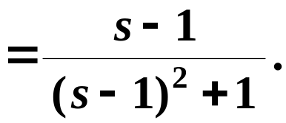

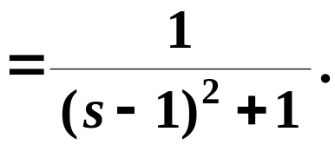
㖎㐃㭹㶟㫝㰻㭐㪌㮊㫝㰻
#
C
o
p
y
r
i
g
h
t
©
2
0
1
4
~
2
0
9
9
.
2. 㪌㮊㫝㰻
P 224
㫝㰻䶨䶩
㧞 a 㪈㥷㭎㗅㒺㨞㐂
㯱㭼
®
X
i
e
s
o
n
g
f
a
@
H
U
S
T
.
$
9
8
!
㰷㠗䶢䶣
㐁㟄㐇
䍤
䈻
㺖
㞶㥟䶩䶠
#
C
o
p
y
r
i
g
h
t
©
2
0
1
4
~
2
0
9
9
.
®
X
i
e
s
o
n
g
f
a
@
H
U
S
T
.
$
9
8
䍤
䈻
㺖
!

Slide 13


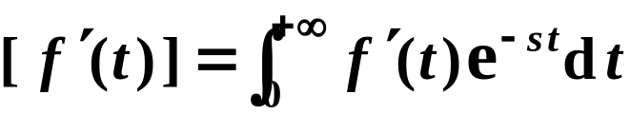
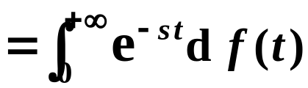
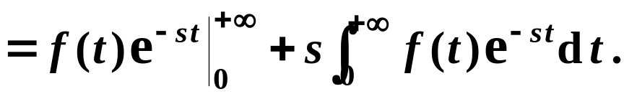



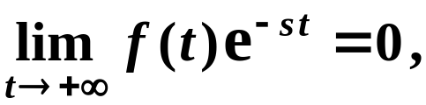
㦘㐃㪹㖻㫝㰻
#
C
o
p
y
r
i
g
h
t
©
2
0
1
4
~
2
0
9
9
P 218
.
▲
1. 㔭㨞㔻㫑㙽㨞
P 218
㫝㰻䶨䶩
®
X
i
e
s
o
n
g
f
a
@
H
U
S
T
.
$
9
8
!
(1)
㰷㠗䶢䶣
䍤
䈻
㺖
#
C
o
p
y
r
i
g
h
t
©
2
0
1
4
~
2
0
9
9
.
(2)
㮂
㭼
㭨㓆㐂㔳 㧀㐂
㭼
®
X
i
e
s
o
n
g
f
a
@
H
U
S
T
.
$
9
8
䍤
䈻
㺖
!
㜶㕛

Slide 14




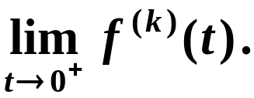
㦘㐃㪹㖻㫝㰻
#
C
o
p
y
r
i
g
h
t
©
2
0
1
4
~
2
0
9
9
P 218
.
▲
1. 㔭㨞㔻㫑㙽㨞
P 218
㫝㰻䶨䶩
®
X
i
e
s
o
n
g
f
a
@
H
U
S
T
.
$
9
8
!
㭎㑳㕟㐂
㭼
䍤
䈻
㺖
#
C
o
p
y
r
i
g
h
t
©
2
0
1
4
~
2
0
9
9
.
㤆㯣㐂 㭮㟂㝀㪈
®
Laplace 㑍㚟㔻㱁㭎㫝㰻㗛㒺㱙㮐㐂㝳㮀㟀㤴㝀㪹㖻
X
i
e
s
o
n
g
f
a
@
H
U
S
T
.
$
9
8
䍤
䈻
㺖
!
㗉㓌㐁㰥㐇㔻㒮㯫㪜㩗㐆
§
㐁 9.4 㛜㯡㠧㜾㨌㐇

Slide 15






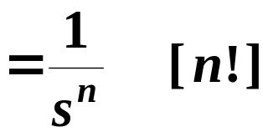
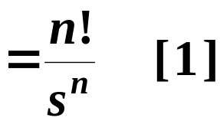
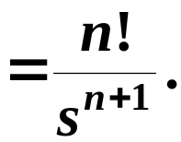


㤴㙽㨞 㔻 Laplace 㑍㚟㐁 n 㪈㰓㱑㨞㐇㐆
㞶䶅䶆䶇
P 219 例 9.7
#
C
o
p
y
r
i
g
h
t
©
2
0
1
4
~
2
0
9
9
.
㝀䶩䶪䶫
㮂 㐂㝳㰝
®
X
i
e
s
o
n
g
f
a
@
H
U
S
T
.
$
9
8
!
㘤㾦㔭㨞㔻㫑㙽㨞㫝㰻㐅
䍤
䈻
㺖
#
C
o
p
y
r
i
g
h
t
©
2
0
1
4
~
2
0
9
9
.
㝳㕛
㙐㭼
®
X
i
e
s
o
n
g
f
a
@
H
U
S
T
.
$
9
8
䍤
䈻
㺖
!

Slide 16




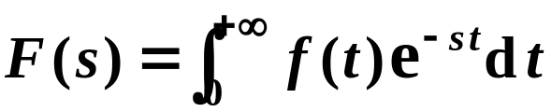
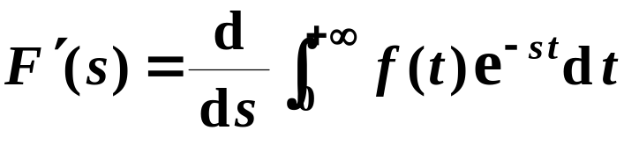
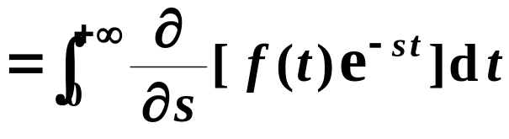
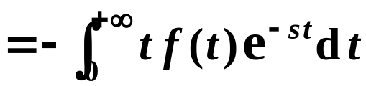
㦘㐃㪹㖻㫝㰻
#
C
o
p
y
r
i
g
h
t
©
2
0
1
4
~
2
0
9
9
.
2. 㫑㙽㨞㔻㔭㨞
P 219
㫝㰻䶨䶩
®
X
i
e
s
o
n
g
f
a
@
H
U
S
T
.
$
9
8
!
㭎㑳㕟㐂
㭼
㰷㠗䶢䶣
㮂 㐂
㭼
䍤
䈻
㺖
#
C
o
p
y
r
i
g
h
t
©
2
0
1
4
~
2
0
9
9
.
®
X
i
e
s
o
n
g
f
a
@
H
U
S
T
.
$
9
8
䍤
䈻
㺖
!
㜤㭎㑛㐂
㝳㕛

Slide 17

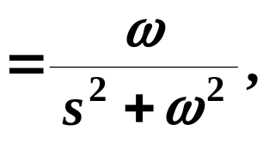

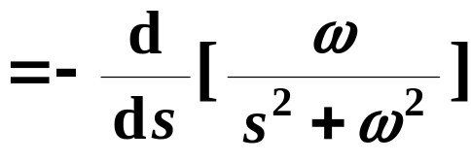

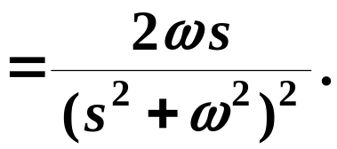



㞶䶅䶆䶇
㤴㙽㨞 㔻 Laplace 㑍㚟㐆
#
C
o
p
y
r
i
g
h
t
©
2
0
1
4
~
2
0
9
9
P 220 例 9.8
.
㝀䶩䶪䶫
㭬㰝
®
㘤㾦㫑㙽㨞㔻㔭㨞㫝㰻㐂
㭼
X
i
e
s
o
n
g
f
a
@
H
U
S
T
.
$
9
8
!
䍤
䈻
㺖
#
C
o
p
y
r
i
g
h
t
©
2
0
1
4
~
2
0
9
9
.
®
X
i
e
s
o
n
g
f
a
@
H
U
S
T
.
$
9
8
䍤
䈻
㺖
!
㭼
㭎㑳㕟㐂

Slide 18



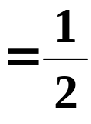

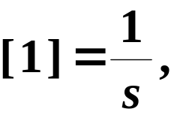
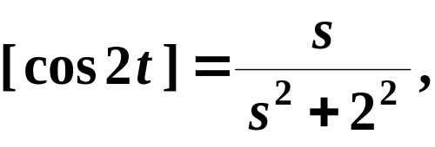






㞶䶅䶆䶇
㤴㙽㨞 㔻 Laplace 㑍㚟㐆
#
C
o
p
y
r
i
g
h
t
©
2
0
1
4
~
2
0
9
9
P 220 例 9.8
.
㝀䶩䶪䶫
㮂㮺
㤂㭬㰝
®
X
i
e
s
o
n
g
f
a
@
H
U
S
T
.
$
9
8
!
㘤㾦㫫㫝㫝㰻㐂
㭼
䍤
䈻
㺖
#
C
o
p
y
r
i
g
h
t
©
2
0
1
4
~
2
0
9
9
.
㜤㭎㑛㐂㘤㾦㫑㙽㨞㔻㔭㨞㫝㰻㐂
㭼
®
X
i
e
s
o
n
g
f
a
@
H
U
S
T
.
$
9
8
䍤
䈻
㺖
!
有
一般地，

Slide 19












㦰㐃㛺㖻㫝㰻
#
C
o
p
y
r
i
g
h
t
©
2
0
1
4
~
2
0
9
9
P 220
.
1. 㛺㖻㔻㫑㙽㨞
P 220
㫝㰻䶨䶩
®
X
i
e
s
o
n
g
f
a
@
H
U
S
T
.
$
9
8
!
㰷㠗䶢䶣
㞴
㯱㭼 㐂
㤂
䍤
䈻
㺖
㘤㾦㪹㖻㫝㰻㐂
㭼
#
C
o
p
y
r
i
g
h
t
©
2
0
1
4
~
2
0
9
9
.
®
X
i
e
s
o
n
g
f
a
@
H
U
S
T
.
$
9
8
䍤
䈻
㺖
!
㜶㕛

Slide 20


㦰㐃㛺㖻㫝㰻
#
C
o
p
y
r
i
g
h
t
©
2
0
1
4
~
2
0
9
9
P 220
.
1. 㛺㖻㔻㫑㙽㨞
P 220
㫝㰻䶨䶩
®
X
i
e
s
o
n
g
f
a
@
H
U
S
T
.
$
9
8
!
㭎㑳㕟㐂
㭼
䍤
䈻
㺖
#
C
o
p
y
r
i
g
h
t
©
2
0
1
4
~
2
0
9
9
.
㰷㠗䶢䶣
㐁㟄㐇
®
X
i
e
s
o
n
g
f
a
@
H
U
S
T
.
$
9
8
䍤
䈻
㺖
!

Slide 21









#
C
o
p
y
r
i
g
h
t
©
2
0
1
4
~
2
0
9
9
㞶䶅䶆䶇
㤴㙽㨞 㔻 Laplace 㑍㚟㐆
.
㝀䶩䶪䶫
㭬㰝
®
X
i
e
s
o
n
g
f
a
@
H
U
S
T
.
$
9
8
㘤㾦㪹㖻㫝㰻㐂
㭼
!
䍤
䈻
㺖
#
C
o
p
y
r
i
g
h
t
©
2
0
1
4
~
2
0
9
9
㜤㭎㑛㐂㘤㾦㛺㖻㫝㰻㐂
㕛
.
®
X
i
e
s
o
n
g
f
a
@
H
U
S
T
.
$
9
8
䍤
䈻
㺖
!

Slide 22




㦰㐃㛺㖻㫝㰻
#
C
o
p
y
r
i
g
h
t
©
2
0
1
4
~
2
0
9
9
.
2. 㫑㙽㨞㔻㛺㖻
P 221
㫝㰻䶨䶩
®
X
i
e
s
o
n
g
f
a
@
H
U
S
T
.
$
9
8
!
㭎㑳㕟㐂
㭼
䍤
䈻
㺖
#
C
o
p
y
r
i
g
h
t
©
2
0
1
4
~
2
0
9
9
.
㰷㠗䶢䶣
㐁㟄㐇
®
X
i
e
s
o
n
g
f
a
@
H
U
S
T
.
$
9
8
䍤
䈻
㺖
!

Slide 23









#
C
o
p
y
r
i
g
h
t
©
2
0
1
4
~
2
0
9
9
㞶䶅䶆䶇
.
㤴㙽㨞 㔻 Laplace 㑍㚟㐆
P 221 例 9.10
㝀䶩䶪䶫
㭬㰝
®
X
i
e
s
o
n
g
f
a
@
H
U
S
T
.
$
9
8
!
㘤㾦㫑㙽㨞㔻㛺㖻㫝㰻㐂
㭼
䍤
䈻
㺖
#
C
o
p
y
r
i
g
h
t
©
2
0
1
4
~
2
0
9
9
.
[㰕]
㐖㰗㔩㮮㐂㦚㧨㜊㘢㜶㪈
㜤㭎㑛㐂㥟㘢㞴 s = 0，
㝳㕛
®
X
i
e
s
o
n
g
f
a
@
H
U
S
T
.
$
9
8
䍤
䈻
㺖
!
㝳㜒㐂㟠㮀 Laplace 㑍㚟㝳㭖㜘㧒㡁㬙㘜㮮㛺㖻㐆
㐁㜤㥳?㐇

Slide 24


㫛㜊䶂䶃䶄
㑫㖻㜴㑗㫝㰻㼜㰃
#
C
o
p
y
r
i
g
h
t
©
2
0
1
4
~
2
0
9
9
.
㫫㫝㫝㰻
®
X
i
e
s
o
n
g
f
a
@
H
U
S
T
.
$
9
8
!
㫩㦠㫝㰻
䍤
䈻
㺖
#
C
o
p
y
r
i
g
h
t
©
2
0
1
4
~
2
0
9
9
.
㭹㶟㫝㰻
®
X
i
e
s
o
n
g
f
a
@
H
U
S
T
.
$
9
8
䍤
䈻
㺖
!
㪌㮊㫝㰻

Slide 25





㫛㜊䵹䵺䵻
㑫㖻㜴㑗㫝㰻㼜㰃
#
C
o
p
y
r
i
g
h
t
©
2
0
1
4
~
2
0
9
9
.
㪹㖻㫝㰻
®
X
i
e
s
o
n
g
f
a
@
H
U
S
T
.
$
9
8
!
䍤
䈻
㺖
#
C
o
p
y
r
i
g
h
t
©
2
0
1
4
~
2
0
9
9
.
㛺㖻㫝㰻
®
X
i
e
s
o
n
g
f
a
@
H
U
S
T
.
$
9
8
䍤
䈻
㺖
!

Slide 26












㪊㐃㯷㤤㙽㨞㔻㫑㙽㨞
#
C
o
p
y
r
i
g
h
t
©
2
0
1
4
~
2
0
9
9
P 224
.
㫝㰻䶨䶩
㧞 㧂 㡲㭖 T 㪈㯷㤤㔻㙽㨞㐂㤂㱛㕫㺶㻷 ,
㯱㭼
®
X
i
e
s
o
n
g
f
a
@
H
U
S
T
.
$
9
8
!
㰷㠗䶢䶣
㜚㪈
䍤
䈻
㺖
#
C
㞴
o
p
y
r
i
g
h
t
©
2
0
1
4
~
2
0
9
9
㤆㯣㐂
.
®
X
i
e
s
o
n
g
f
a
@
H
U
S
T
.
$
9
8
䍤
䈻
㺖
!
㜶㕛

Slide 27












㞶䶅䶆䶇
㤴㤄㵣㱑䁃㚇㔻㰓㬏㵣 㔻㫑㙽㨞㐆
P 225 例 9.14
#
C
o
p
y
r
i
g
h
t
©
2
0
1
4
~
2
0
9
9
.
㝀䶩䶪䶫
㭬㰝㙽㨞 㔻㯷㤤㪈
®
㘤㾦㯷㤤㙽㨞㔻㫑㙽㨞㔻㫝㰻㐂
㭼
X
i
e
s
o
n
g
f
a
@
H
U
S
T
.
$
9
8
!
䍤
䈻
㺖
#
C
o
p
y
r
i
g
h
t
©
2
0
1
4
~
2
0
9
9
.
®
X
i
e
s
o
n
g
f
a
@
H
U
S
T
.
$
9
8
䍤
䈻
㺖
!

Slide 28












㟰㐃㝎㛺㭐㝎㛺㔩㟂
#
C
o
p
y
r
i
g
h
t
©
2
0
1
4
~
2
0
9
9
P 225
.
1. 㝎㛺
P 225
㘤㾦 8.3 㜐㯣㝎㛺㔻㔩㮮㐂㟦㙀㙽㨞㔻㝎㛺㪈㐅
㖻㫧䶪䶫
§
®
X
i
e
s
o
n
g
f
a
@
H
U
S
T
.
$
9
8
!
㥟㘢㙽㨞㠝㱣㐅
㔳 㧀㐂
㯱㭼
䍤
䈻
㺖
#
C
o
p
y
r
i
g
h
t
©
2
0
1
4
~
2
0
9
9
.
®
X
i
e
s
o
n
g
f
a
@
H
U
S
T
.
$
9
8
䍤
䈻
㺖
㜶
!

Slide 29



㟰㐃㝎㛺㭐㝎㛺㔩㟂
#
C
o
p
y
r
i
g
h
t
©
2
0
1
4
~
2
0
9
9
P 225
.
1. 㝎㛺
P 225
㐖㰗 9.1 㜐㯣㙽㨞㔻㮌㔩㐂
㔫㮺 Laplace 㑍㚟㖐㮴㐂
㖻㫧䶪䶫
§
®
X
i
e
s
o
n
g
f
a
@
H
U
S
T
.
$
9
8
!
㥷㙹㙽㨞 㩕㒺㝳㭖㕃㩃㮺㙽㨞
㭨㓆㐂㯹㑗㰡㯣㟦㙀㙽㨞㔻㝎㛺㰙㛦㔩㮮㪈㐅
䍤
䈻
㺖
#
C
o
p
y
r
i
g
h
t
©
2
0
1
4
~
2
0
9
9
.
㰕䶂䶃䶄
㮂㦚㦺㘪㒬㔻㝎㛺㥝㥣㠝㱣㛆㚟㟢㐃㜊㚅㟢㛘㖻㣋㟢㐆
®
X
i
e
s
o
n
g
f
a
@
H
U
S
T
.
$
9
8
䍤
䈻
㺖
!

Slide 30









㞶䶅䶆䶇
㤴㙽㨞 㭐 㔻㝎㛺㐆
#
C
o
p
y
r
i
g
h
t
©
2
0
1
4
~
2
0
9
9
P 225 例 9.15
.
㝀䶩䶪䶫
®
X
i
e
s
o
n
g
f
a
@
H
U
S
T
.
$
9
8
!
䍤
䈻
㺖
#
C
o
p
y
r
i
g
h
t
©
2
0
1
4
~
2
0
9
9
.
®
X
i
e
s
o
n
g
f
a
@
H
U
S
T
.
$
9
8
䍤
䈻
㺖
!

Slide 31








㟰㐃㝎㛺㭐㝎㛺㔩㟂
#
C
o
p
y
r
i
g
h
t
©
2
0
1
4
~
2
0
9
9
.
2. 㝎㛺㔩㟂
P 225
㔩㟂䶡䶢
®
X
i
e
s
o
n
g
f
a
@
H
U
S
T
.
$
9
8
!
㰷㠗䶢䶣
㯿㑥 =
䍤
䈻
㺖
㐁䉬㘴?㐇
#
C
o
p
y
r
i
g
h
t
©
2
0
1
4
~
2
0
9
9
.
D
®
X
i
e
s
o
n
g
f
a
@
H
U
S
T
.
$
9
8
䍤
䈻
㺖
!

Slide 32







㟰㐃㝎㛺㭐㝎㛺㔩㟂
#
C
o
p
y
r
i
g
h
t
©
2
0
1
4
~
2
0
9
9
.
2. 㝎㛺㔩㟂
P 225
㔩㟂䶡䶢
®
X
i
e
s
o
n
g
f
a
@
H
U
S
T
.
$
9
8
!
㰷㠗䶢䶣
㯿㑥 =
䍤
䈻
㺖
㤆㯣㐂
#
C
o
p
y
r
i
g
h
t
©
2
0
1
4
~
2
0
9
9
.
㞴
®
㯿㑥 =
= 㭤㑥。
X
i
e
s
o
n
g
f
a
@
H
U
S
T
.
$
9
8
䍤
䈻
㺖
!

Slide 33










#
C
o
p
y
r
i
g
h
t
©
2
0
1
4
~
2
0
9
9
㞶䶅䶆䶇
㭬㰝 㤴
.
P 226 例 9.16
㮂㮺
㝀䶩䶪䶫
®
X
i
e
s
o
n
g
f
a
@
H
U
S
T
.
$
9
8
!
㙐㭼
䍤
䈻
㺖
#
C
o
p
y
r
i
g
h
t
©
2
0
1
4
~
2
0
9
9
.
®
X
i
e
s
o
n
g
f
a
@
H
U
S
T
.
$
9
8
䍤
䈻
㺖
!

Slide 34

#
C
o
p
y
r
i
g
h
t
©
2
0
1
4
~
2
0
9
9
.
®
X
i
e
s
o
n
g
f
a
@
H
U
S
T
.
$
9
8
!
䍤
䈻
㺖
#
C
o
p
y
r
i
g
h
t
©
2
0
1
4
~
2
0
9
9
.
®
X
i
e
s
o
n
g
f
a
@
H
U
S
T
.
$
9
8
䍤
䈻
㺖
!
……
放松一下吧 !

Slide 35








㗙㐅
㟠㮀 Laplace 㑍㚟㜘㧒㘜㮮㛺㖻
#
C
o
p
y
r
i
g
h
t
©
2
0
1
4
~
2
0
9
9
P 222 [注]
.
㯹 Laplace 㑍㚟㛘㤆㫝㰻㯣㐂㥟㘢㤌 s 㪈㡁㬙㩛㔩㔻㯫 ,
㨘㬕䵧䵨䵩
㝈㝳㭖㮀㟀㤴㭎㬙㙽㨞㔻㘜㮮㛺㖻㐆
®
X
i
e
s
o
n
g
f
a
@
H
U
S
T
.
$
9
8
!
㞶㥟䶩䶠
䍤
䈻
㺖
#
C
o
p
y
r
i
g
h
t
©
2
0
1
4
~
2
0
9
9
.
㰕㭶䶣䶤
㯹㦢㮀㱁㬙㘐㦺㧀㑓㬃㽫㨩㐂㑓㮐㧀㫿㮐㦞㫓㞅㓪㭎㫉
®
X
i
e
s
o
n
g
f
a
@
H
U
S
T
.
$
9
8
䍤
䈻
㺖
!
㘜㮮㛺㖻㔻㒶㯹㫝㭖㛘 s 㔻㤌㯫㗏㪠㐆

Slide 36









㗙㐅
㟠㮀 Laplace 㑍㚟㜘㧒㘜㮮㛺㖻
#
C
o
p
y
r
i
g
h
t
©
2
0
1
4
~
2
0
9
9
.
㞶䶦䶧䶨
㜘㧒㛺㖻
P 222 例 9.11 (1)
㝀䶲䶳䶴
㭬㰝
®
X
i
e
s
o
n
g
f
a
@
H
U
S
T
.
$
9
8
!
㯹㦚㦺㯣㐂㤌 s = 3 ，
㜶㕛
䍤
䈻
㺖
#
C
o
p
y
r
i
g
h
t
©
2
0
1
4
~
2
0
9
9
.
®
X
i
e
s
o
n
g
f
a
@
H
U
S
T
.
$
9
8
䍤
䈻
㺖
!

Slide 37









㗙㐅
㟠㮀 Laplace 㑍㚟㜘㧒㘜㮮㛺㖻
#
C
o
p
y
r
i
g
h
t
©
2
0
1
4
~
2
0
9
9
.
㞶䶦䶧䶨
㜘㧒㛺㖻
P 222 例 9.11 (2)
®
X
i
e
s
o
n
g
f
a
@
H
U
S
T
.
$
9
8
!
(1)
㝀䶲䶳䶴
㭬㰝
㘤㾦㛺㖻㫝㰻㐂
㭼
䍤
䈻
㺖
#
C
o
p
y
r
i
g
h
t
©
2
0
1
4
~
2
0
9
9
.
®
X
i
e
s
o
n
g
f
a
@
H
U
S
T
.
$
9
8
䍤
䈻
㺖
!

Slide 38







㗙㐅
㟠㮀 Laplace 㑍㚟㜘㧒㘜㮮㛺㖻
#
C
o
p
y
r
i
g
h
t
©
2
0
1
4
~
2
0
9
9
.
㞶䶦䶧䶨
㜘㧒㛺㖻
P 222 例 9.11 (2)
®
X
i
e
s
o
n
g
f
a
@
H
U
S
T
.
$
9
8
!
(1)
㝀䶲䶳䶴
䍤
䈻
㺖
㜶
#
C
o
p
y
r
i
g
h
t
©
2
0
1
4
~
2
0
9
9
.
(2)
㯹㦚㦺㯣㐂㤌 s = 1 㐂
㜶㕛
®
X
i
e
s
o
n
g
f
a
@
H
U
S
T
.
$
9
8
䍤
䈻
㺖
!
㐁㗕㚡㐇

Slide 39
#
C
o
p
y
r
i
g
h
t
©
2
0
1
4
~
2
0
9
9
.
®
X
i
e
s
o
n
g
f
a
@
H
U
S
T
.
$
9
8
!
䍤
䈻
㺖
#
C
o
p
y
r
i
g
h
t
©
2
0
1
4
~
2
0
9
9
.
®
X
i
e
s
o
n
g
f
a
@
H
U
S
T
.
$
9
8
䍤
䈻
㺖
!
……
放松一下吧 !

